Slide 1

Proconnect
Quad Squad
Pavan Kumar Jonnadula
Sri Nikhitha Boddapati
Vamsi Alapaty
Sukumar Bodapati

Slide 2
Problem Statement
UmKC Pathway
UMKC Canvas
UMKC Connect

Slide 3
Features
JWT Authentication
Password Encryption using b-crypt
Single Sign-On for all the UMKC Website info.

Slide 4
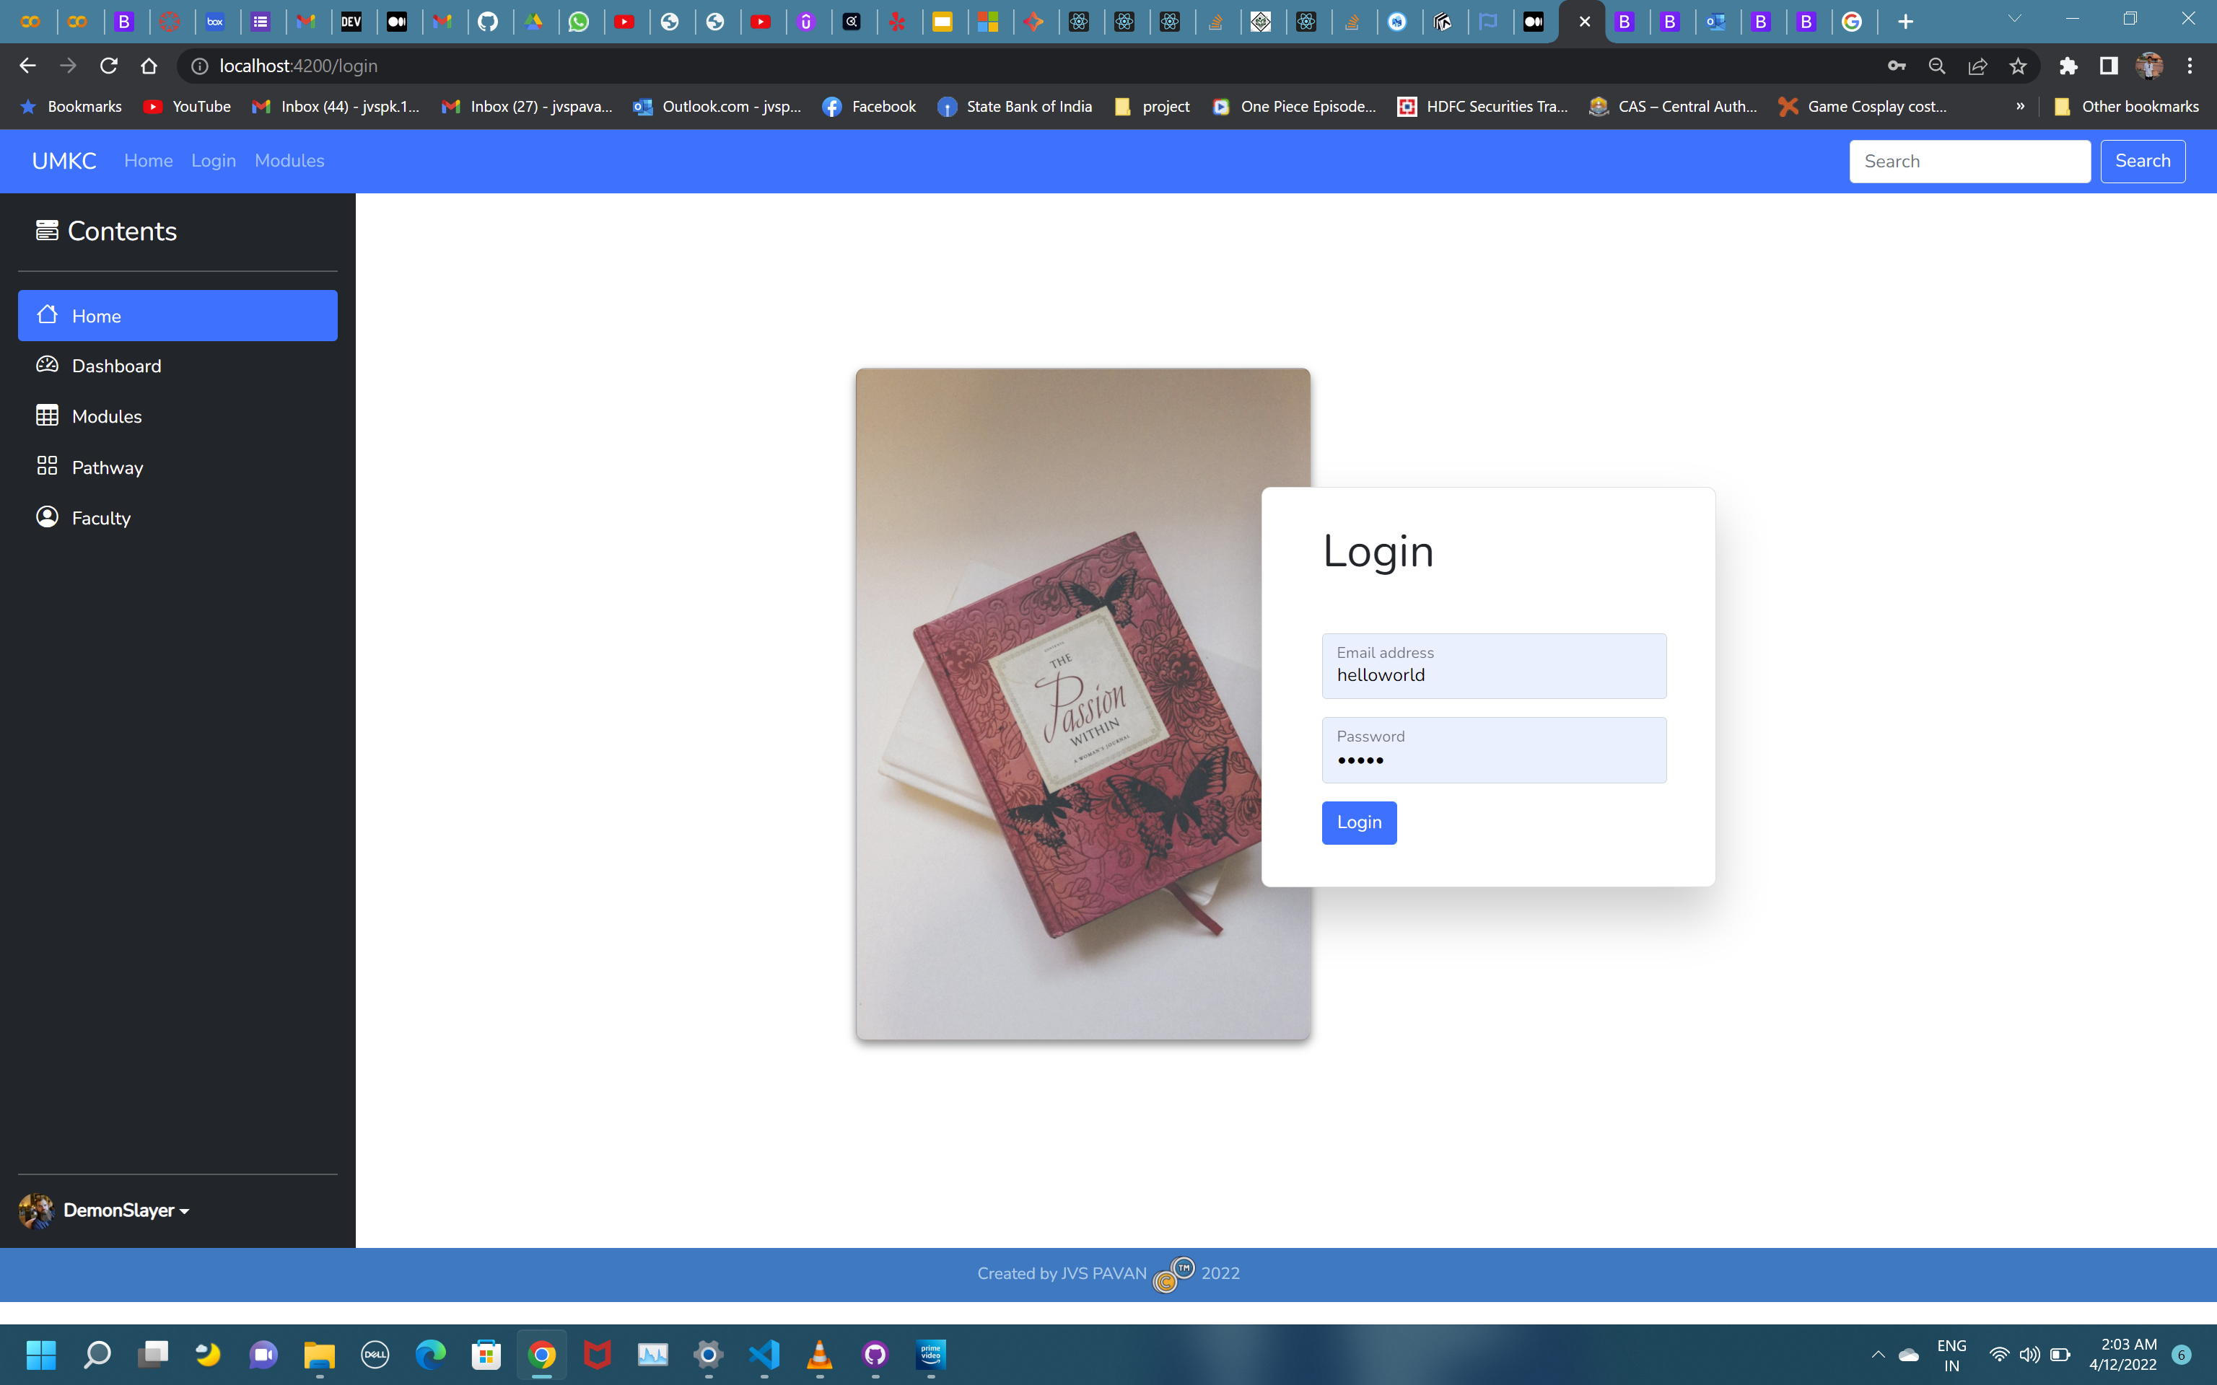
Design Elements
Tried to Implement the existing applications, so that users will not feel like new view.

Slide 5
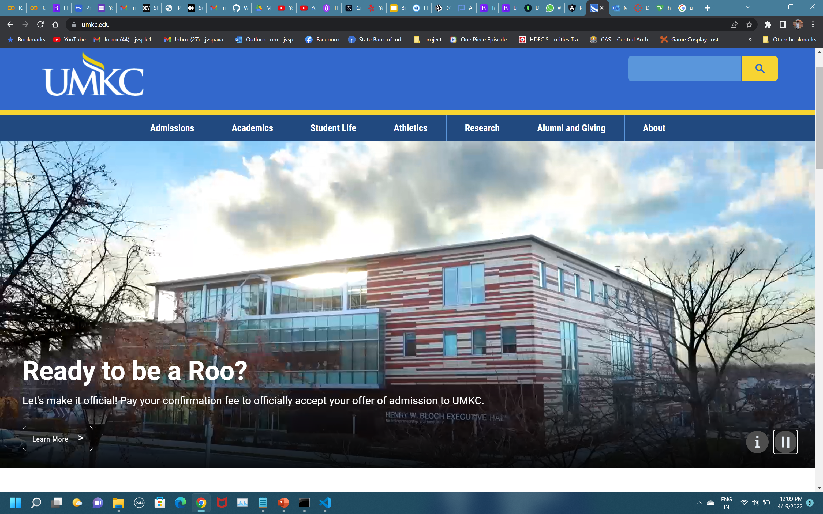
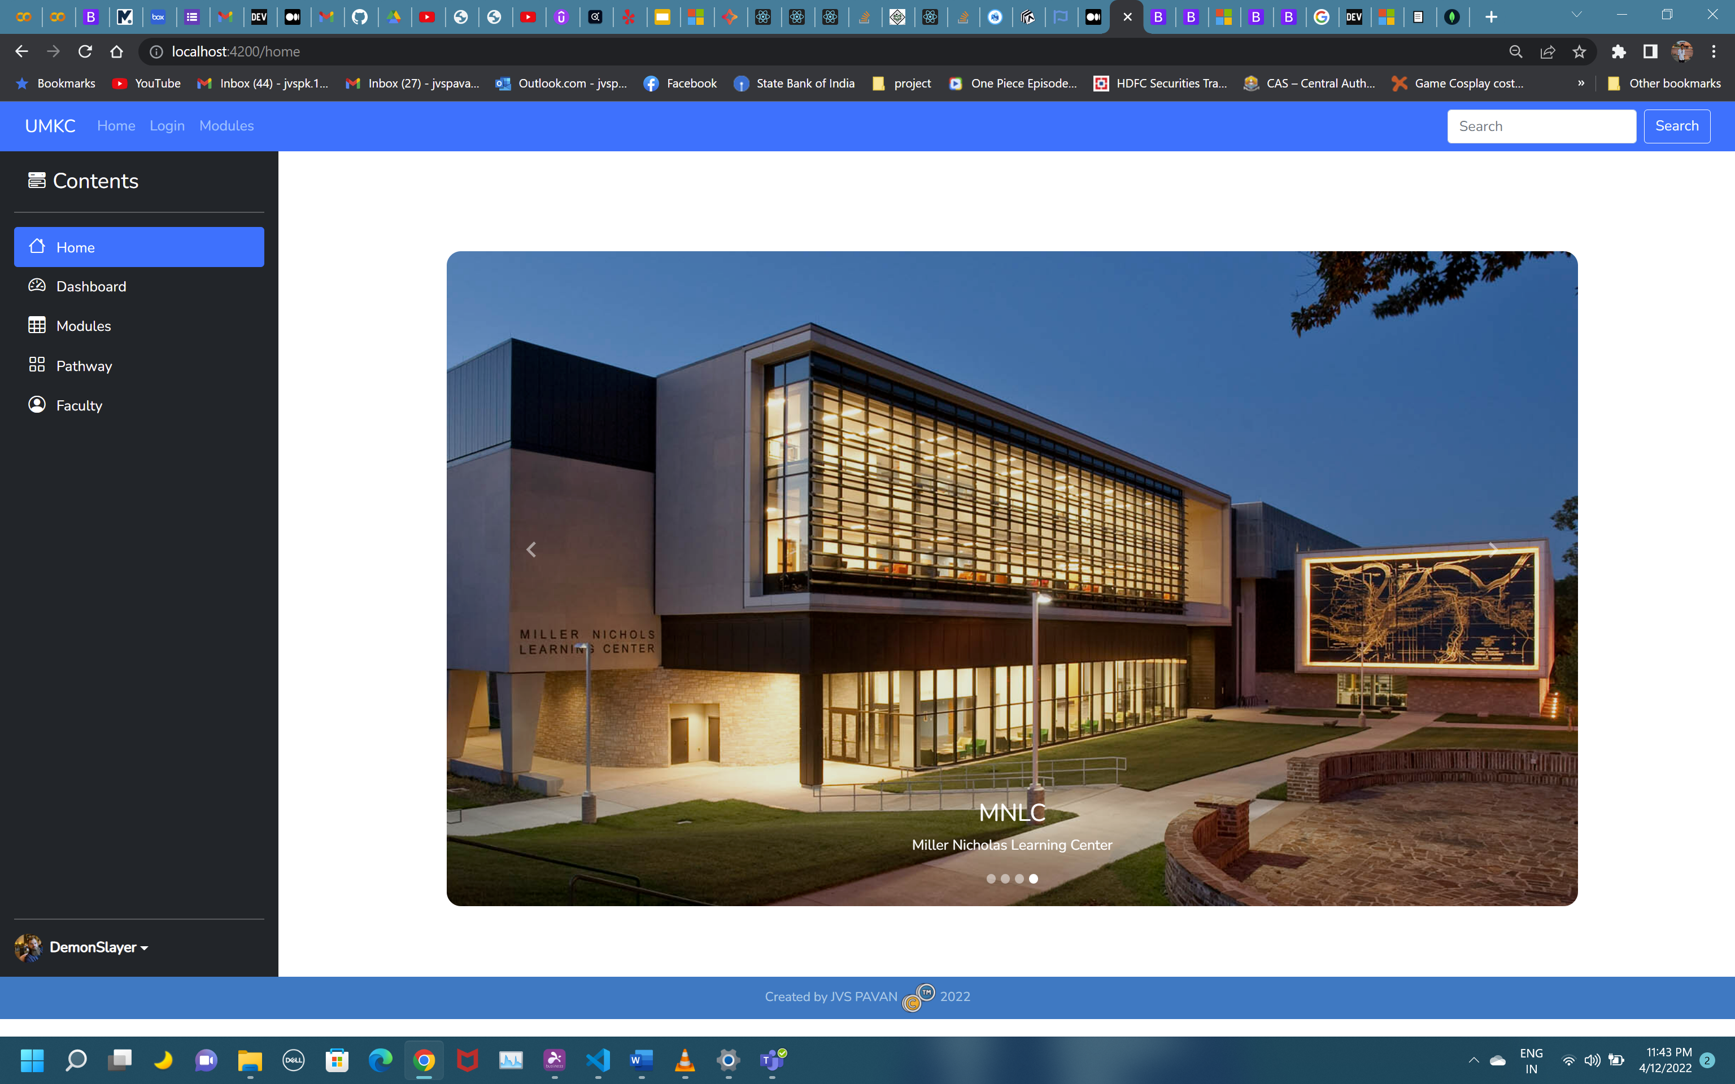
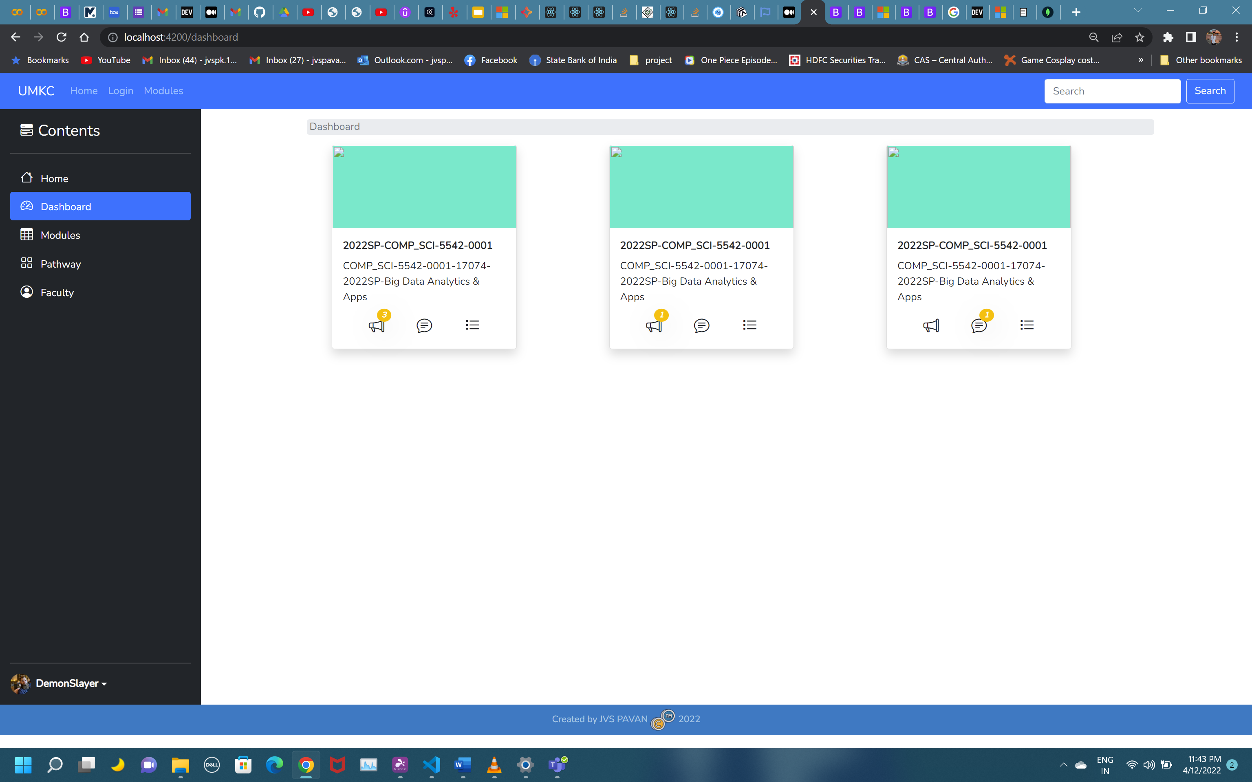
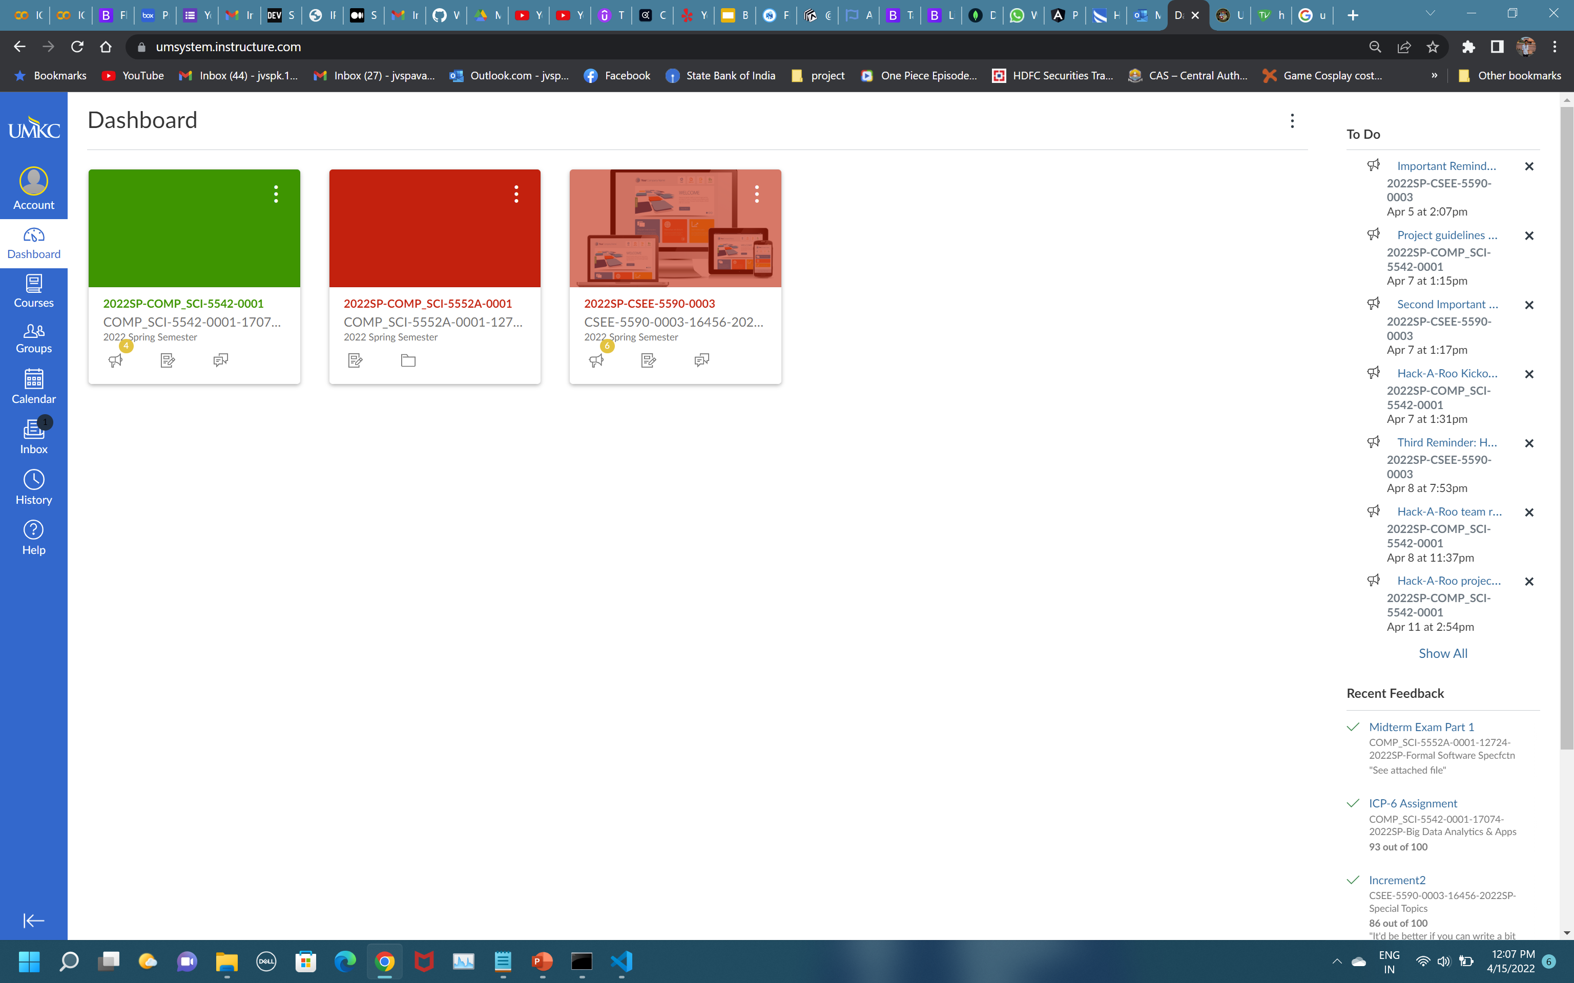
Design Elements

Slide 6
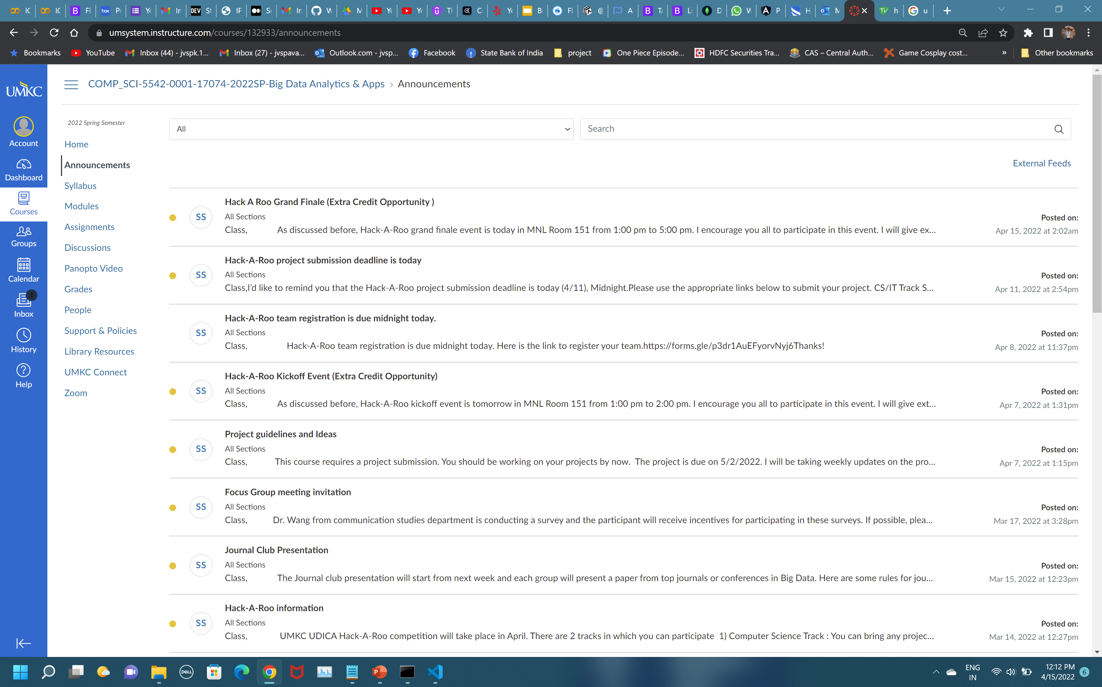
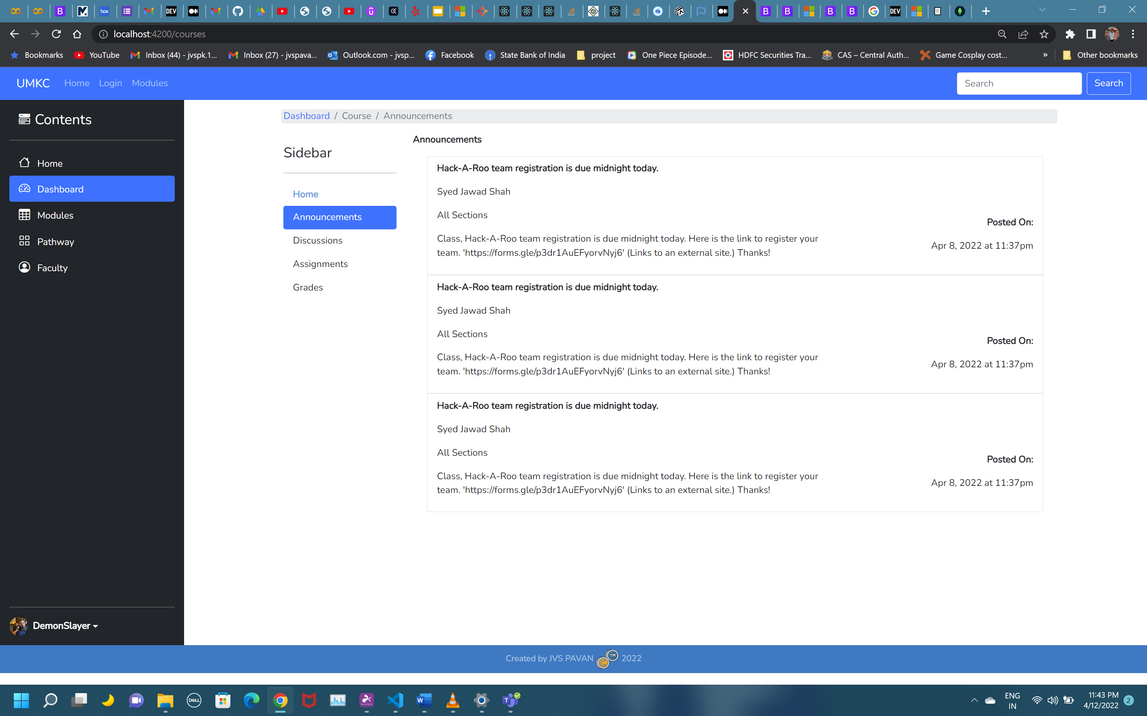
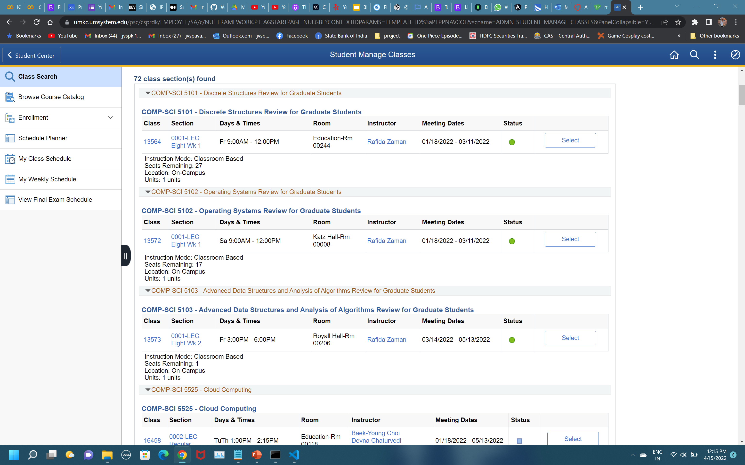
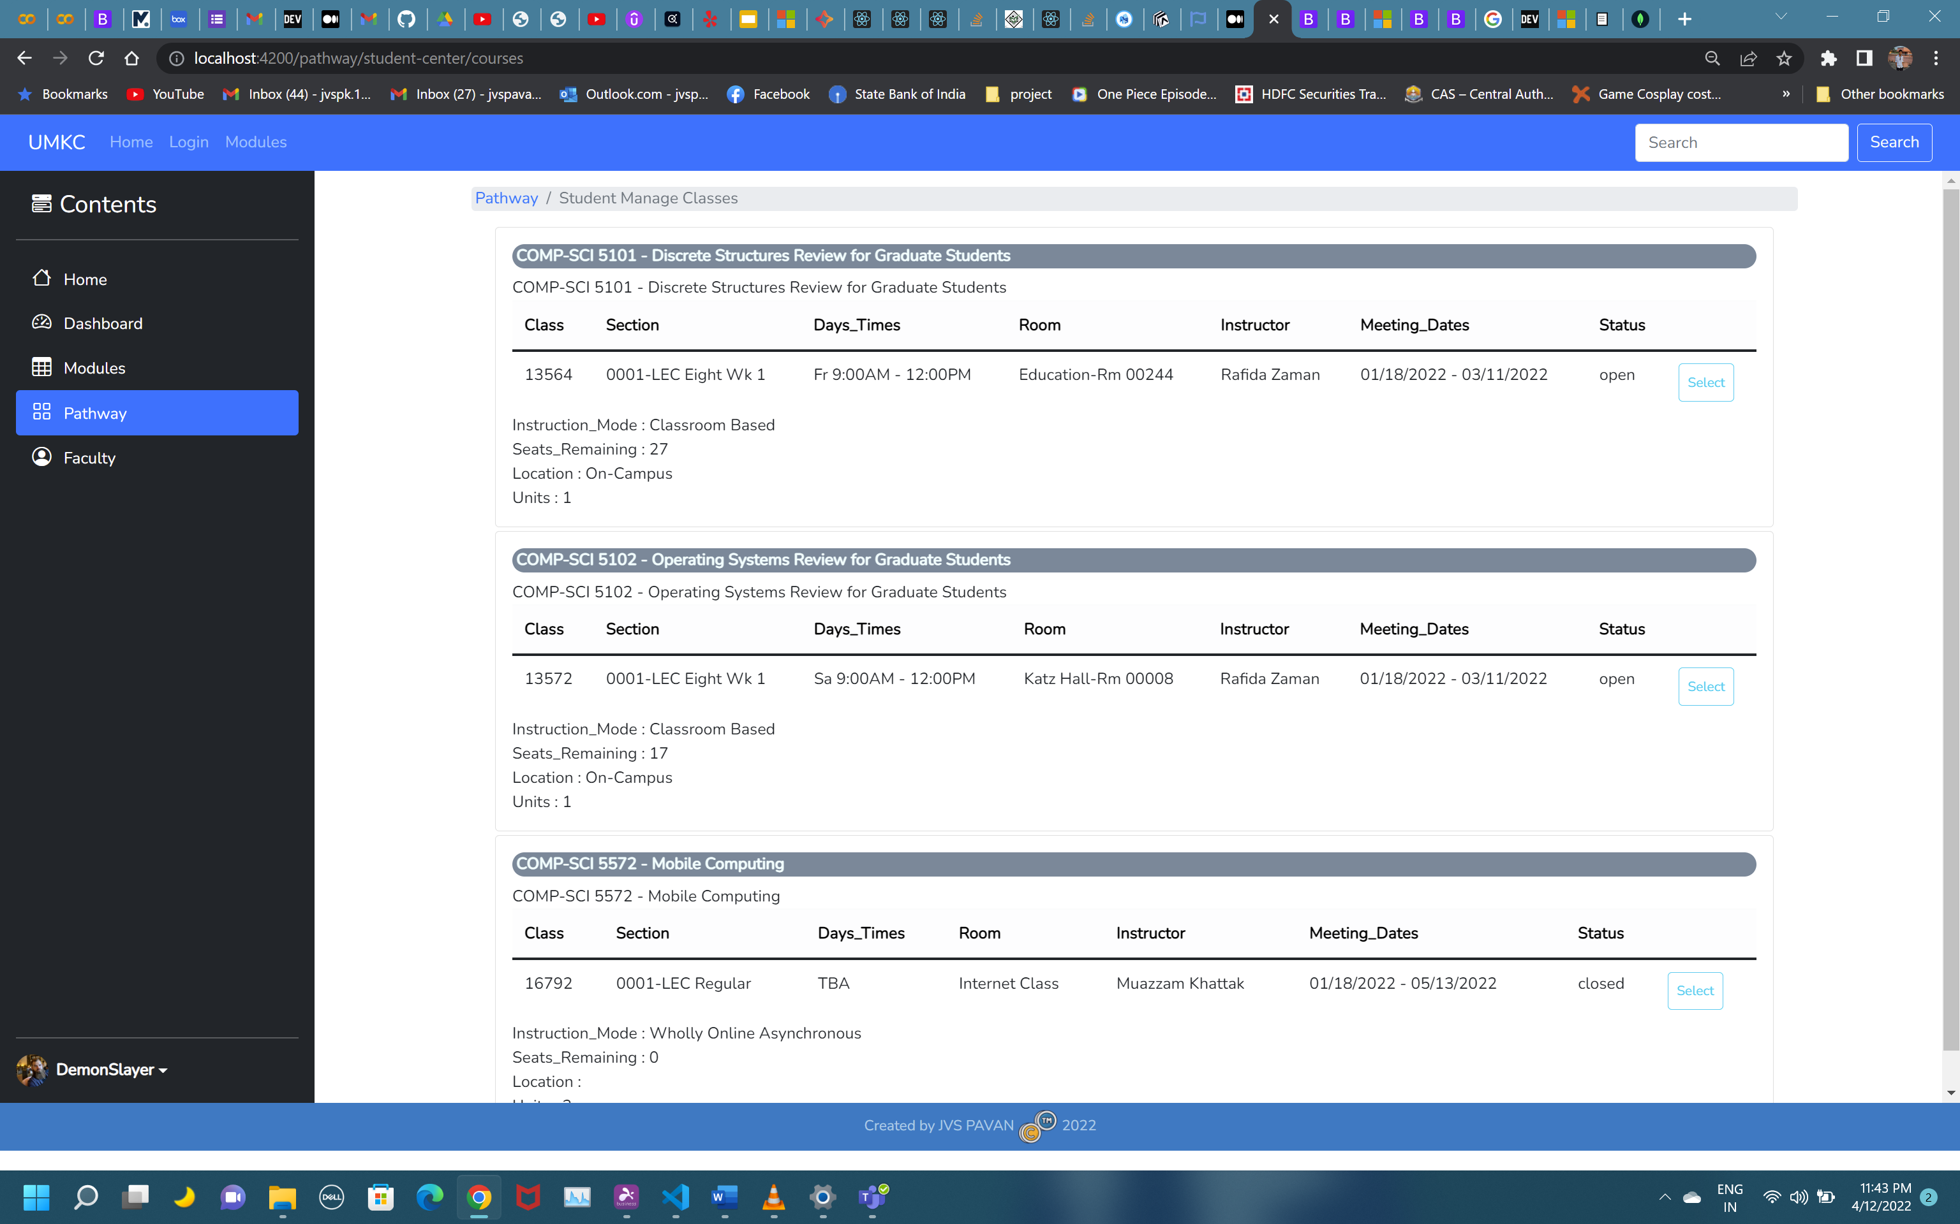

Slide 7
Thankyou…

